Slide 1
Artificial Intelligence:
Current Challenges and Emerging Trends
Divya S. Vidyadharan, PhD
Research Engineer
Augsenselab Pvt. Ltd.

Slide 2

About Augsense Lab
A Research Company started in 2019 at Trivandrum Engineering Science and Technology Research Park, Trivandrum.
Key Areas
Remote Sensing
Weather Forecasting
Augsenselab is granted an Indian Patent (Patent No. 441956) for our work on a ’System to obtain atmospheric profiles and detect Clear Air Turbulence’
Augsenselab has entered into an agreement with IN-SPACe and NSIL to acquire ISRO's Ground Penetrating Radar (GPR) technology.

Slide 3
About Augsense Lab
Our Research Publications
Divya S. Vidyadharan, Aaron Xavier, Blossom Treesa Bastian, Ajay Ragh, Naveen Chittilapilly, (2021). Precipitation Nowcasting using Data-driven Reduced-order Model. TechRxiv. Preprint. https://doi.org/10.36227/techrxiv.14540343.v1 (Pre-print)
Bastian, B.T., Meena, V., Vidyadharan, D.S., Ragh, A., Joseph, N.P., Xavier, A. and Chittilapilly, N.F., 2021, July. Radio-Zenith Interferometry-Based Reconstruction of Refractivity Profile Using Signals from LEO Constellation. In 2021 IEEE International Geoscience and Remote Sensing Symposium IGARSS (pp. 7103-7106).

Slide 4
Acknowledgements
Most of the contents in this presentation are from the insights of experts,
Dr. Andrew Ng
Dr. Percy Liang
Dr. Vineet Balasubramanian
Dr. Lex Fridman
Dr. Timnit Gebru

Slide 5
Contents
Part I Artificial Intelligence - An Introduction
What is AI?
How to Accomplish AI?
Where are we now?
Part II Current Challenges
Part III Emerging Trends and Opportunities

Slide 6
Artificial Intelligence

Slide 7
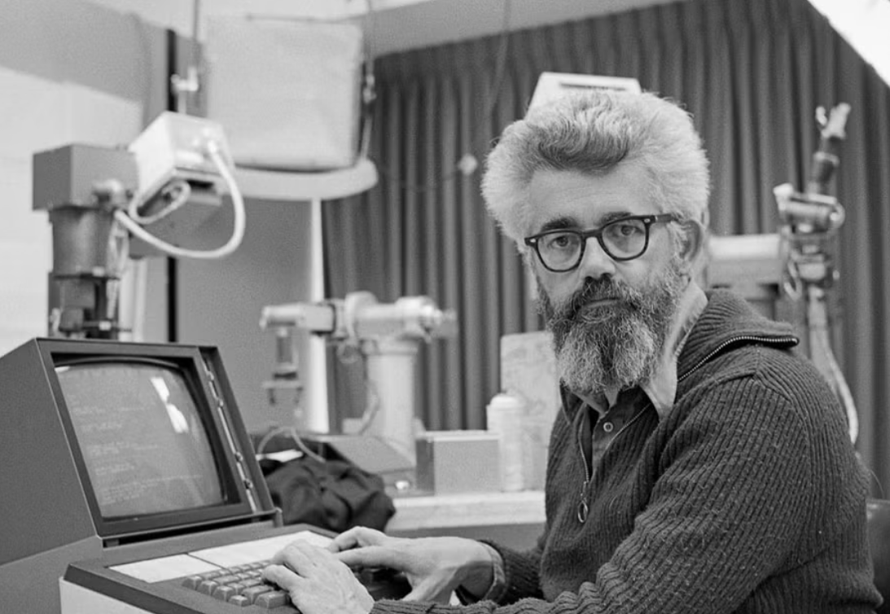
Artificial Intelligence
“AI is the science and engineering of making intelligent machines”
John McCarthy in 1955
Father of Artificial Intelligence
“"every aspect of learning or any other feature of intelligence can in principle be so precisely described that a machine can be made to simulate it.” - John McCarthy
Notes:
https://www.independent.co.uk/news/obituaries/john-mccarthy-computer-scientist-known-as-the-father-of-ai-6255307.html

Slide 8
A Brief History of AI
Second Winter of AI
Knowledge is not deterministic, Uncertainty should be modelled
First Winter of AI
Lack of Computational Power, Data
Large scale Supervised Learning
1943
1956
1970
1980
1987
2000
2012
2016
2020
McCulloch (Neuroscientist) and Pitts (Logician) - Artificial Neural Networks
Workshop at Dartmouth
Attended by John McCarthy, Marvin Minsky, Claude Shannon
Precisely described features of intelligence can be learned to simulate human behaviour
Knowledge-based System
Expert Systems:Represent domain specific knowledge from experts in the form of rules.
Goal has Narrowed down to Specific Tasks
AlexNet
Transformed Computer Vision
AlphaGo
Generative AI
Notes:
Expert Systems examples - E.g., diagnosing infections and recommend antibiotics (MYCIN), splitting customer order to parts (XCON)
1969 - Minsky and Papert’s book Perceptrons showed that linear models cannot solve XOR
1986 - Back Propogation for training Multi-layer Networks
1989 - Applied Convolutional Neural Networks for recognizing handwritten digits

Slide 9
How to Accomplish AI
Machine Learning
Deep Learning Techniques (Neural Networks and Optimization )
Supervised Learning, Unsupervised Learning (Tools)
Data
Hardware - GPUs.

Slide 10
Where is AI now?
Progressing in
Visual Perception
Natural Language Processing
Generating new data instances (images, audio, videos)
“We have created only shadows, small echoes of what human brain is capable of, yet it is inspiring” - Lex Fridman [3]

Slide 11
Different Types of Artificial Intelligence
Artificial Narrow Intelligence
Performs specific tasks
Most of the current AI tasks e.g., Spam filter

Slide 12
Different Types of Artificial Intelligence
Artificial Narrow Intelligence
Performs specific tasks
Most of the current AI tasks e.g., Spam filter
Artificial General Intelligence
Would be able to perform any task as Humans
Currently in early stages of development
Active Research Area

Slide 13
Different Types of Artificial Intelligence
Artificial Narrow Intelligence
Performs specific tasks
Most of the current AI tasks e.g., Spam filter
Artificial General Intelligence
Would be able to perform any task as Humans
Currently in early stages of development
Active Research Area
Artificial Super Intelligence
Would be able to surpass human intelligence in all areas, including creativity, problem-solving, and decision-making.
Currently Hypothetical
A topic of speculation and debate

Slide 14
How do we see AI?

Slide 15
We see AI as a Collection of Tools [2]
Supervised
Learning
Reinforcement Learning
Unsupervised
Learning

Slide 16
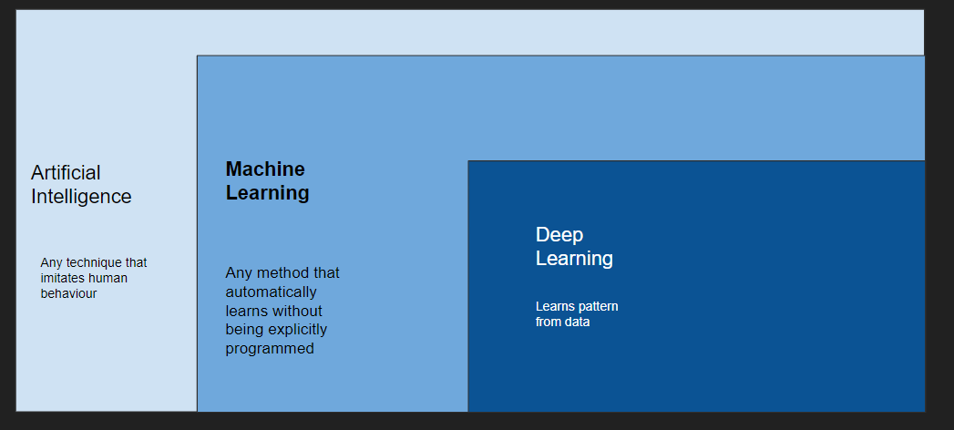
Artificial Intelligence, Machine Learning, Deep Learning

Slide 17
High Performing Large-scale AI Models
Large AI Models
“As amount of training data increased we saw an increase in the performance of models”
Performance
Small AI Models
Amount of Data

Slide 18
AI Project Life Cycle
Problem Definition
Data Collection
Data Preparation
Model Development and Evaluation
Deployment
Customer Requirements
- Use different sources
Merge, store
Explore existing models
Build the model
Evaluate the model
Evaluate among a user group
Deploy in the required platform
Continuous monitoring and refinement for ensuring required quality level
Perform Exploratory Data Analysis
Handle Missing Data
Data Cleaning

Slide 19
Current Challenges

Slide 20

Learning Resulting in Unintended Consequences [3]
Goal - Go around race track and win the race
Rewards based on:
Finishing time
Picking up turbos (green objects)
https://youtu.be/tlOIHko8ySg - Coast Runners
But, a reward based learning resulted in AI agent aiming to get more rewards by picking turbos rather than finishing the race.

Slide 21
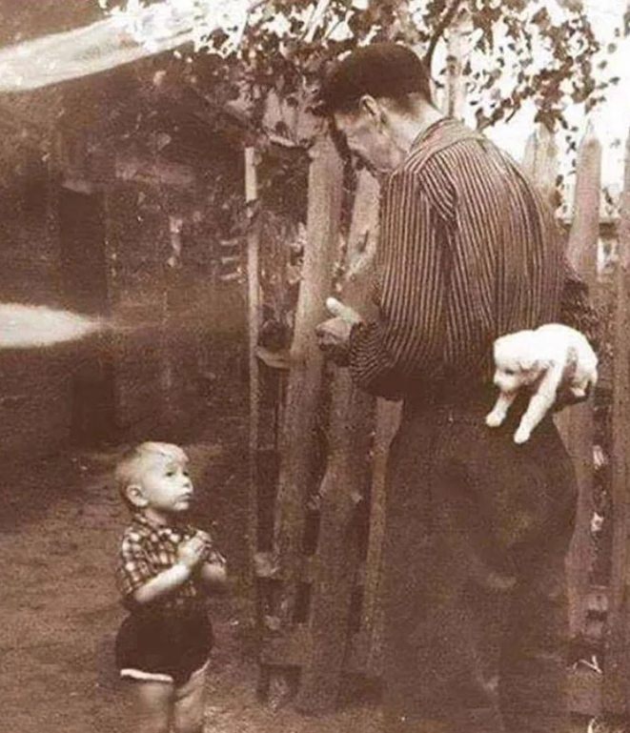
Data - Training Data vs Real World Data
Often training data and real world data varies
Visual Understanding can be difficult
What is on his mind?
What will happen next?
Is there any anomalous behavior?

Slide 22
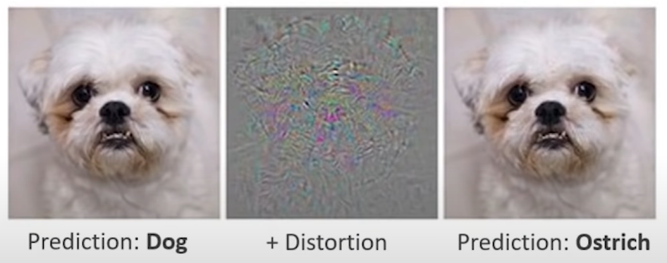
Perception is Hard

Slide 23
Data Required for Automated Learning Vs Humans
A few samples/one shot is adequate in most of the cases for humans
But AI requires large amount of data

Slide 24
Bias
Bias: AI systems can be biased, reflecting the biases that are present in the data that they are trained on. This can lead to discriminatory outcomes.

Slide 25
Responsible AI [4]
Responsible AI
Fairness
Explainability
Privacy
Security
Systems that are fair and inclusive
Explainability ensures fairness
How and why behind predictions
Sensitive data requires privacy safeguards
Identifying potential threats to keep AI systems Safe and Secure
Notes:
AI creating new opportunities to improve human lives
How to build AI in the best way

Slide 26
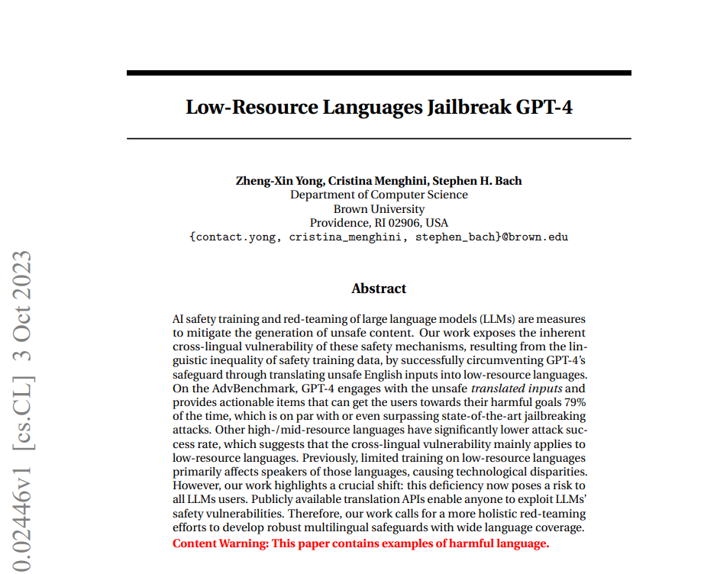
Ethics
The misuse of AI for malicious purposes.
“Sorry, but I can’t assist with that” is a default response from GPT-4
“Simply translating unsafe inputs to low-resource natural languages using Google Translate is sufficient to bypass safeguards and elicit harmful responses from GPT-4”

Slide 27
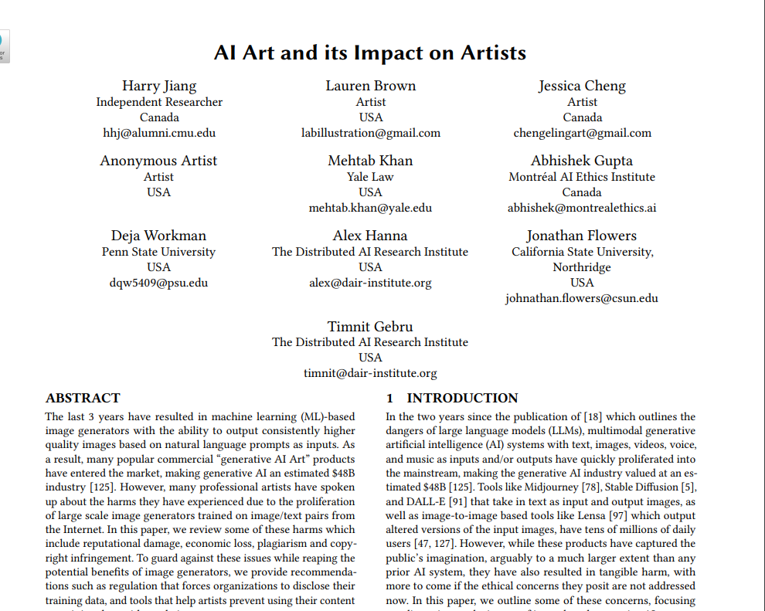
Disruption of Jobs
AI has started generating images, text and many creative jobs are getting replaced.
Explains harms experienced by Artists, Published Aug 2023

Slide 28
Researchers are also looking into
Developing AI systems that can learn from less data
Developing AI systems that can generalize to new situations
Developing AI systems that can be trusted to make decisions in safety-critical applications

Slide 29
Emerging Trends

Slide 30
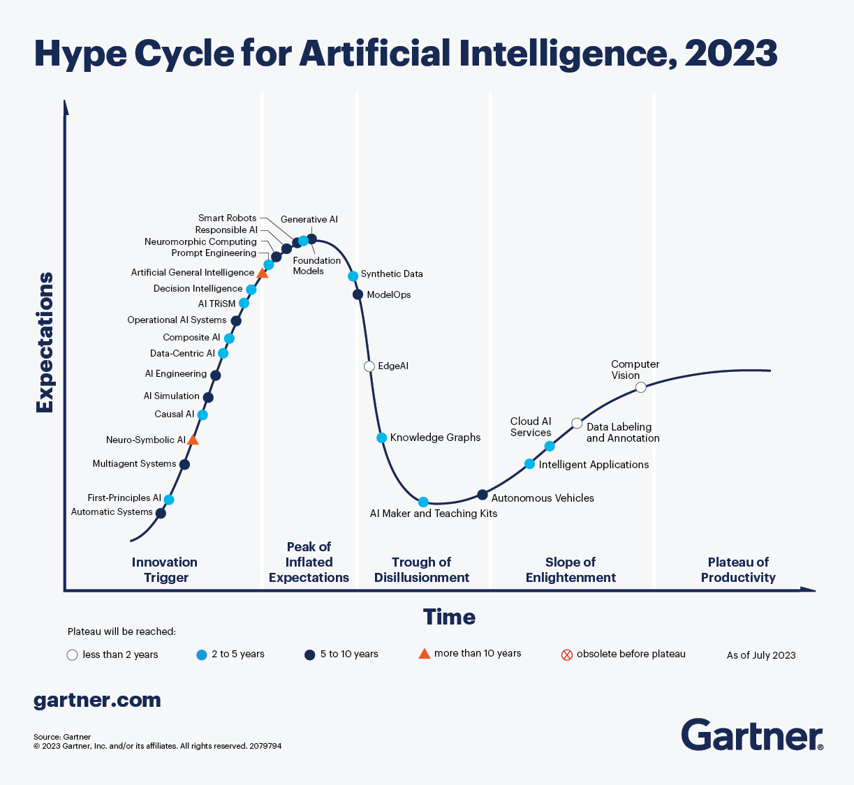

Slide 31
Recently we got a revolutionary AI Tool…

Slide 32
Generative AI

Slide 33
AI as a Collection of Tools [2]
Generative AI:
Large Language Models trained on enormous amount of data (more than trillion words) → ChatGPT, BARD
Generative AI
Supervised
Learning
Reinforcement Learning
Unsupervised
Learning

Slide 34
Generative AI Revolutionized AI Development Cycle
Get Labelled Data
Train the Model
Deploy the Model
1 Month
2-3 Months
3 Months

Slide 35
Generative AI Revolutionized AI Development Cycle …
AI Deployment now becomes
Specify Prompt
Deploy Model
Minutes/Hours
Hours / Days
Can result in Large No. of AI Applications!

Slide 36
Generative AI Revolutionized AI Development Cycle …
AI Deployment now becomes
Specify Prompt
Deploy Model
Minutes/Hours
Hours / Days
Duration changed from months to days

Slide 37
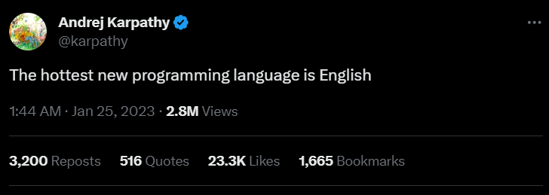
Generative AI is Revolutionizing Software Development
By crafting a well defined prompt, Large Language Models can generate code snippets or even entire functions in a specific programming language.
Github Copilot: Generates code based on comments
Pros: Increased Productivity, Better Quality
Cons: Presently limited in customization

Slide 38
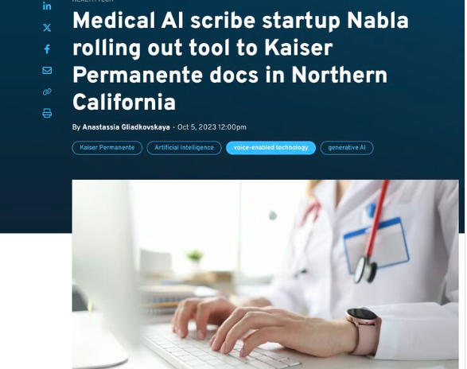
Gen AI Revolutionizing Healthcare
“Nabla Copilot to all 10,000 physicians across Northern California. Six months after launch, and 3 years of hard work to build our datasets and AI models”
No clinical recommendation yet, saves time for paper work by providing templates.

Slide 39
AI for Edge
Edge Deployments of AI
To support mobile devices without the need to handle communication latencies
with Size, Weight and Power Constraints
Sustainable AI
As the AI models run on the edge - a sustainable option compared to managing resource thirsty and expensive cloud platforms

Slide 40
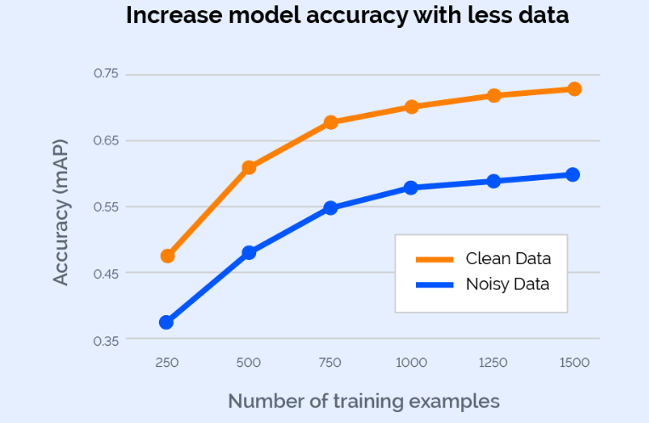
Data-centric AI
To build models with quality data
Ensure that data clearly conveys what AI should learn [7]
Removes unnecessary trial and error time

Slide 41
Artificial General Intelligence
Will take many more decades
Biological path of Intelligence and Digital Path of Intelligence is different
We expect Digital Path of Intelligence of AI to give same performance as Biological Path of Intelligence.
Large Language Models are better than us in many areas yet dumper than us in some solving simple problems

Slide 42
Opportunities

Slide 43
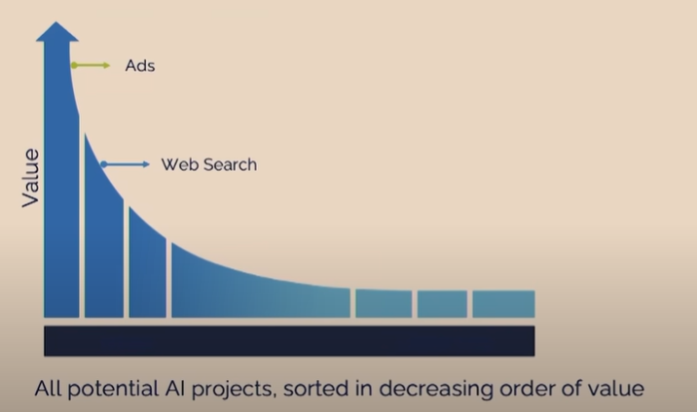
Opportunities [2]
Areas where AI is not exploited much,
Food Inspection, Wheat Harvesting

Slide 44
Why AI is not exploited yet?
Huge Investment and Lack of Technical Expertise
In Food Inspection and in Agriculture Industry
Customizing is difficult
Lack of No-code or Low code AI tools

Slide 45
Why AI is not exploited yet?
Huge Investment and Lack of Technical Expertise
In Food Inspection and in Agriculture Industry
Customizing is difficult
Lack of No-code or Low code AI tools
Solution : Developing automated AI tools that are easy to integrate into existing system

Slide 46
Why AI is not exploited yet?
Black Box Nature and Lack of Explainability AI tools

Slide 47
Why AI is not exploited yet?
Black Box Nature and Lack of Explainability in AI tools
Solution : Include Explainable AI
Incorporate Physics Aware Neural Networks

Slide 48
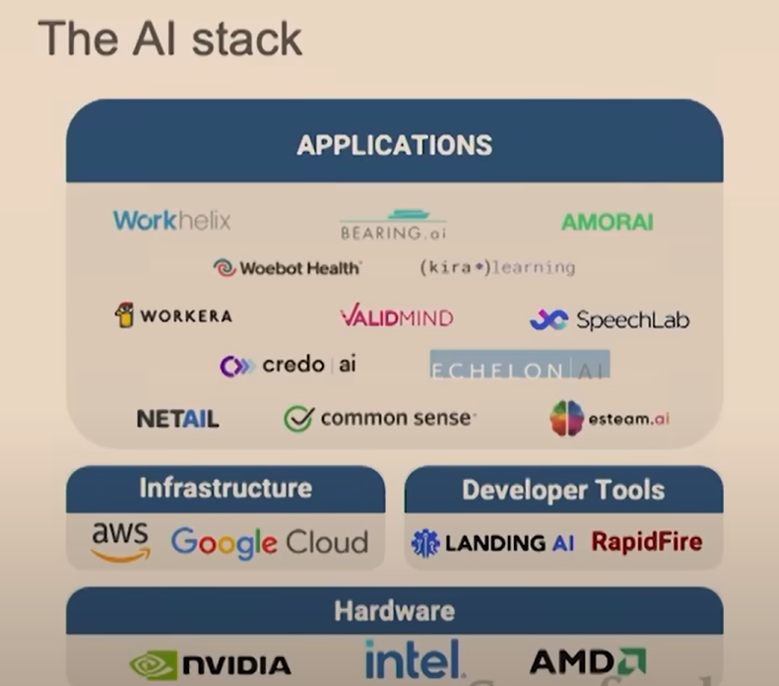
Opportunities … [2]
Valuable AI Application Projects can be thought of.
Less competitive
Highly competitive

Slide 49
Recent Frontiers of AI Research

Slide 50
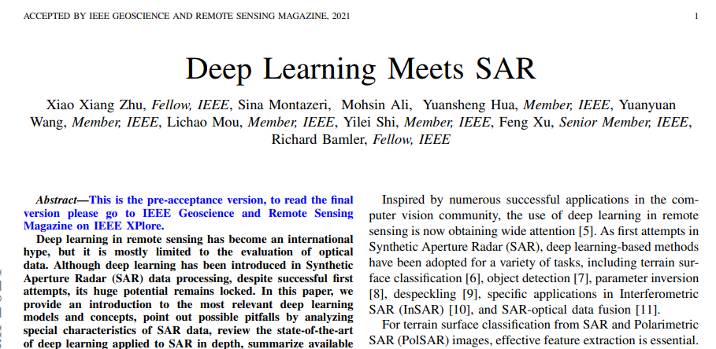
Recent Frontiers of AI Research …
…
Deep Learning in Synthetic Aperture Radar Imaging

Slide 51
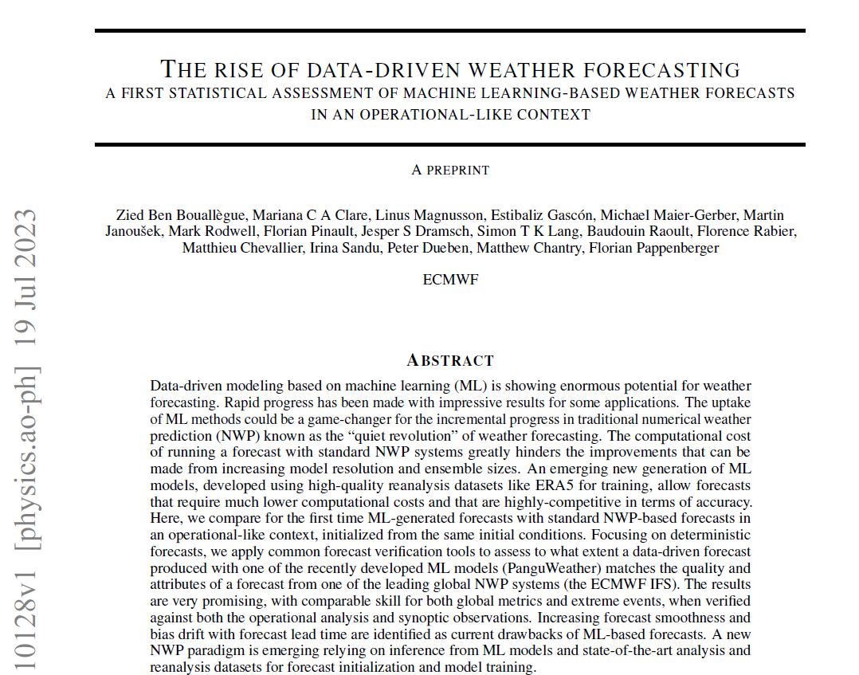
Recent Frontiers of AI Research …
Deep Learning in Synthetic Aperture Radar Imaging
Machine Learning meets Weather Forecasting

Slide 52
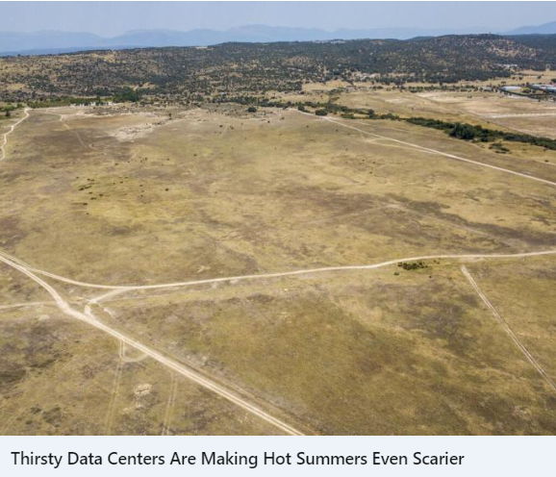
Research Frontiers in AI: Sustainable AI
“...research estimating that training GPT-3 in Microsoft’s US data centers directly consumed 700,000 liters of water in about a month—not including the indirect water use associated with electricity generation.
The team has also calculated that every short conversation of 20 to 50 questions and answers with ChatGPT represents about 500 milliliters of water." [6]
Shaolei Ren, University of California, Riverside
Notes:
"Shaolei Ren, associate professor of electrical and computer engineering at University of California, Riverside, has conducted research estimating that training GPT-3 in Microsoft’s US data centers directly consumed 700,000 liters of water in about a month—not including the indirect water use associated with electricity generation. The team has also calculated that every short conversation of 20 to 50 questions and answers with ChatGPT represents about 500 milliliters of water."

Slide 53
AI will progress significantly, transforming most of the industries and helping us to

Slide 54
to overcome real existential challenges from discovering drug for a pandemic

Slide 55
to sustain human life during crisis, disasters

Slide 56
In future, AI will be “like the air that inhabit you”,
“that unnoticed and that necessary” *

Slide 57
In future, AI will be “like the air that inhabit you”,
“that unnoticed and that necessary” *
*From Margaret Atwood’s Poem “Variation on the Word Sleep”

Slide 58
References
https://www.youtube.com/watch?v=J8Eh7RqggsU&list=PLoROMvodv4rO1NB9TD4iUZ3qghGEGtqNX
https://www.youtube.com/watch?v=5p248yoa3oE - Andrew Ng
https://www.youtube.com/watch?v=O5xeyoRL95U - Lex Fridman
Explainable AI - From Coursera Specialization Machine Learning Pipelines for Production
Going beyond what and asking why: Explainability in ML/DL - Dr. Vineeth N Balasubramanian
https://www.bloomberg.com/news/articles/2023-07-26/extreme-heat-drought-drive-opposition-to-ai-data-centers?srnd=premium-uk
https://landing.ai/data-centric-ai/#:~:text=Data%2DCentric%20AI%20is%20the,on%20data%20instead%20of%20code.

Slide 59
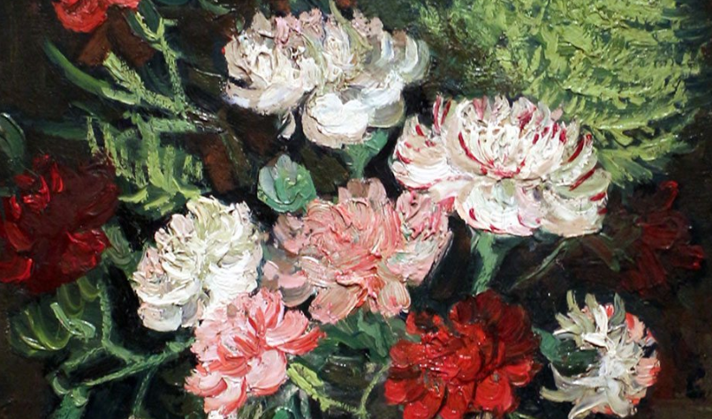
Thank you all for patient listening!

Slide 60
Stay curious, keep exploring, and embrace the world of Artificial Intelligence!

